Slide 1
Individual Meeting
Jason Chang

Slide 2
Outline
GoEdge.ai
Time-series segmentation with better results (time-consuming)
Own Paper
TimeDRL (accepted)
LLM4TS (TIST 2024)
Future Papers
PromptTSS (target: CIKM 2024)

Slide 3
Before we start
TSMC合作
去美國前的合作
暑期實習
只有暑期? 未來是否可以繼續合作?
(題目一) 空拍圖，持續追蹤蓋廠進度
Open dataset
(題目二) Demand forecasting (競爭者分析)
去美國後的合作
與在台灣的合作是否有直接關聯?
綠卡 (很謝謝老師願意幫忙)
UCLA交換
目前只有兩邊老師的同意，沒有任何正式的文件
UCLA那邊申請的deadline? (怕會錯過)
UCAL申請的Program名稱?
我直接問Wei Wang嗎?

Slide 4
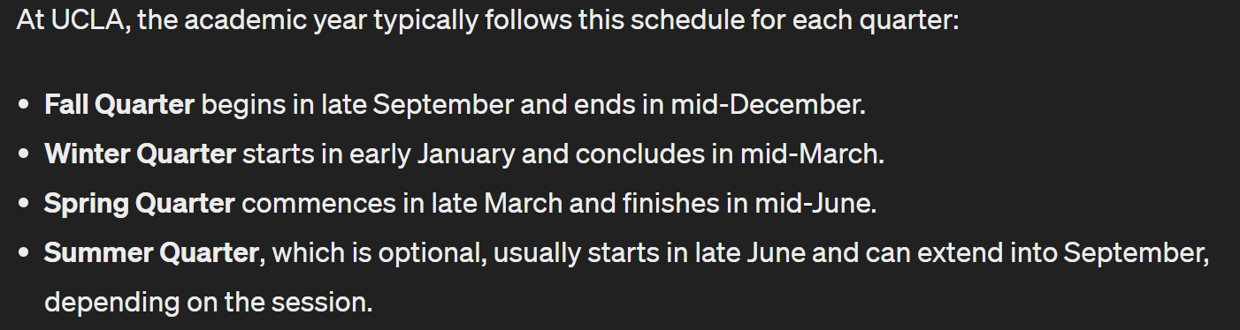
UCLA交換
想要問問看老師這個是否可行?
因為現在優智能經費不確定 夠不夠繼續與我合作
交換時間：一年
獎學金：
千里馬，90萬，博四下~博五上，明年2月出國
華仁全球講座，80萬，博四上~博四下，今年9月出國
如果沒有申請到還是會出國，只是少了獎學金的補助

Slide 5
理想計畫
目前~六月底：PromptTSS
七月~八月底：TSMC summer intern + Journal paper for TimeDRL
台積電薪資
九月~明年六月：UCLA + TSMC collaboration in US
Fall + Winter + Spring
華仁獎學金
台積電薪資
明年七月：口試+畢業
明年八月：TSMC US (綠卡)

Slide 6
GoEdge.ai

Slide 7
Own Paper

Slide 8
Publication Lists (First Author)
LLM4TS (TIST 2024 submitted)
TimeDRL (ICDE 2024 accepted)
TimeDRL-semi (only 25% difference)
Q1 journal (after ICDE acceptance)
TIST, TNNLS, TKDD, TPAMI
After the third paper
PromptTSS
CIKM and ICDM don’t have rebuttal phase? (Even with NeurIPS?)

Slide 9
PromptTSS
Ching Chang

Slide 10
TimeUSS
Unsupervised semantic segmentation on images
(COMUS) Unsupervised Semantic Segmentation with Self-supervised Object-centric Representations
ICLR 2023
(STEGO) Unsupervised Semantic Segmentation by Distilling Feature Correspondences
ICLR 2022
(MaskContrast) Unsupervised Semantic Segmentation by Contrasting Object Mask Proposals
ICCV 2021
(PiCIE) Unsupervised Semantic Segmentation Using Invariance and Equivariance in Clustering
CVPR 2021
Unsupervised semantic segmentation on time-series
(LS-USS) Latent Space Unsupervised Semantic Segmentation
Frontiers in Physiology 2023 (Q2 journal)
PrecTime
Matrix Profile VIII
ClaSP
Time2State
TICC

Slide 11
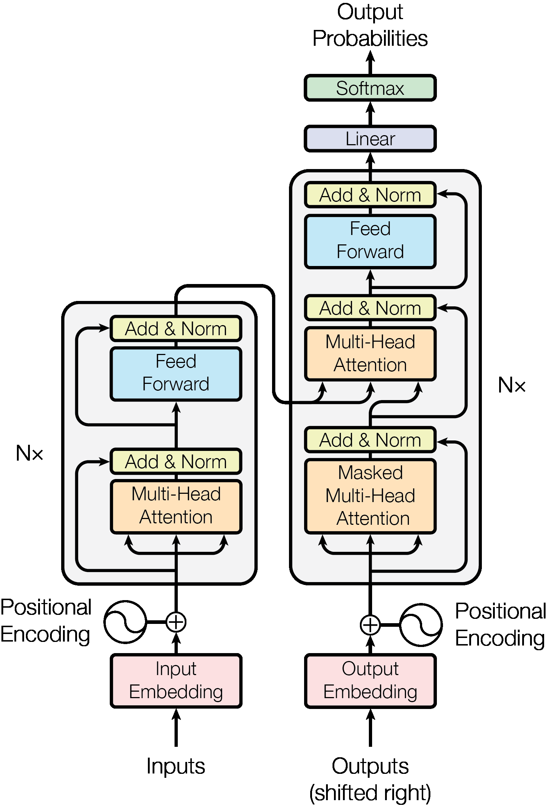
SAM v.s. PromptTSS
Segmentation
GPU
CPU
Final Mask
Image encoder
Mask decoder
Embedding
Prompt encoder
Multi-Head
Attention
Image
Prompt
Time-Series Input Layer
Prompt
Input Layer
Time-Series
Prompts

Slide 12
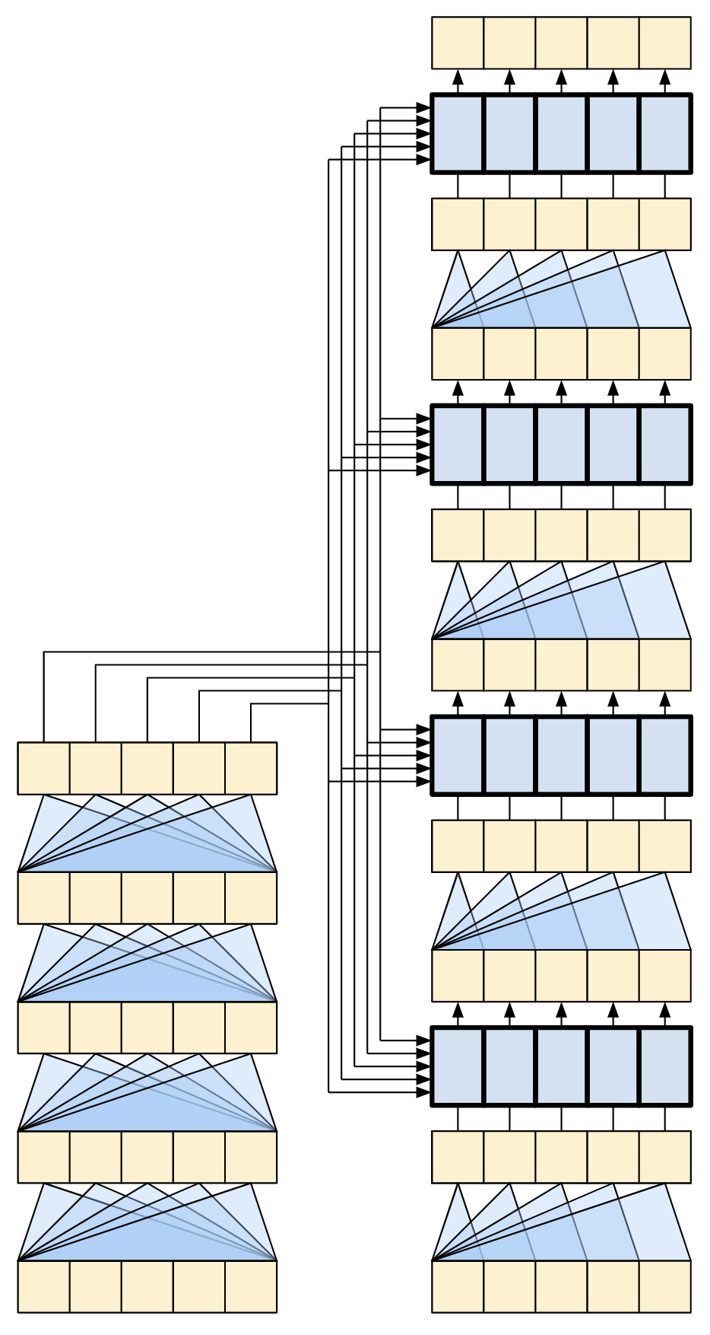
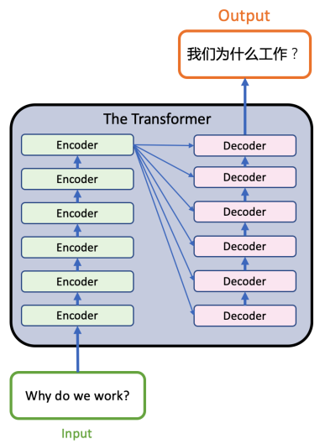
A representation of a 4-layer Transformer

Slide 13
PromptTSS
1. Rearrange (B, T_{p}*D)
2. Dropout
3. Linear (B, T_{in}*K)
4. Rearrange (B, T_{in}, K)
Time-Series
(B, T_{in} , C)
(B, T_{in} , C_{t})
(B, T_{p}, C_{t}*P)
(B, T_{p}, D)
(B, T_{p}, D)
Instance Normalization
(w/o affine)
Patching + Channel-
Independence
Time-Series
Input Layer
Transformer
Encoder
Prompt
(B, T_{in} )
(B, T_{in} , C_{p})
(B, T_{p} , C_{t}*P)
(B, T_{p} , D)
(B, T_{p} , D)
nn.Embedding
Patching + Channel-
Independence
Prompt
Input Layer
Transformer
Decoder
Output Layer
(B, T_{in}, K)

Slide 14
Why promptable?
Leverage more information in the inference stage
Mult-level granularity

Slide 15
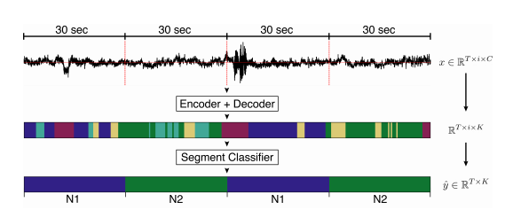
Multiple Granularity of Time-Series Segmentation
Level 1
Level 2
Promptable
Design
Level 2
Level 1
input
output

Slide 16
Thanks for your attention

